Slide 1
ACUTE TRANSCRIPTIONAL RESPONSE · BULK RNA-SEQ TIME COURSE
A Rapid, Coordinated and Transient
Transcriptional Program Triggered by Acute
Netrin-1 Stimulation in Cortical Neurons
5- and 15-minute Netrin-1 time course in E18 rat cortical neurons
PhD Thesis Defense
[ Your name ] · [ Department / Institution ] · [ Date ]
Notes:
~1 min. Good morning. My thesis asks what the neuronal transcriptome does in the first MINUTES after meeting Netrin-1, the classic axon-guidance cue. Using a 5- and 15-minute bulk RNA-seq time course in E18 rat cortical neurons, I find a rapid, coordinated and almost perfectly reversible transcriptional program.

Slide 2
INTRODUCTION
Background: Netrin-1 acts in seconds — but the nucleus?
▸ Netrin-1 is a prototypical axon-guidance cue.
– Steers the growth cone via DCC / UNC5 receptors.
▸ Its canonical mechanism is post-translational & local.
– Cytoskeletal remodeling, local translation — seconds to minutes.
▸ The acute, minute-scale TRANSCRIPTIONAL response is uncharted.
– Most transcriptomic studies sample hours to days.
THE QUESTION
Does acute Netrin-1 rapidly reshape the neuronal transcriptome — and is the change transient or sustained?
A minute-scale window almost no one has looked at.
THIS STUDY
0
5 min
15 min
1 h
hours–days
2
Notes:
~1.5 min. Netrin-1 is the textbook guidance cue, binding DCC/UNC5 to steer the growth cone. Its classic mechanism is post-translational and local — seconds to minutes. Because the action is at the protein level, the field has overlooked what the nucleus does on this fast timescale; most transcriptomic studies sample hours to days, the right of this timeline. So my question: does acute Netrin reshape the transcriptome in minutes, and is it transient or sustained?

Slide 3
AIM
Hypothesis & strategy
HYPOTHESIS
Netrin-1 induces a fast, coordinated transcriptional response that is TRANSIENT — switched on, then off — rather than a stable reprogramming.
Time course
Gene level
Pathway level
Reversibility
Bulk RNA-seq at 0 / 5 / 15 min
Differential expression (DESeq2)
Coordination via GSEA
Compare 5v0 against 15v5
3
Notes:
~1 min. My hypothesis: fast, coordinated, and crucially TRANSIENT. The strategy has four pillars — a 0/5/15-minute time course, gene-level DE with DESeq2, pathway-level GSEA, and the key reversibility test: comparing the 5-vs-0 contrast against 15-vs-5. If the program reverses, those two should be mirror images. Hold that thought.

Slide 4
METHODS
Experimental design
▸ E18 rat cortical mixed primary cultures.
▸ Three conditions:
– Vehicle (PBS, 5 min) — reference / 0 min
– Netrin-1, 5 min · Netrin-1, 15 min
▸ 3 biological replicates → 9 samples.
▸ Design limitation (stated up front):
– One shared PBS-5min control serves both Netrin timepoints; no independent PBS-15min.
– → confounds 15v0; main results use 5v0 and 15v5.
9 SAMPLES = 3 CONDITIONS × 3 REPLICATES
Vehicle / 0 min
rep 1
rep 2
rep 3
Netrin-1 5 min
rep 1
rep 2
rep 3
Netrin-1 15 min
rep 1
rep 2
rep 3
4
Notes:
~1.5 min. E18 cortical cultures, three conditions — vehicle, 5-min and 15-min Netrin — three replicates, nine samples. One limitation I flag immediately: there is a single shared PBS control at 5 minutes for both timepoints, no independent 15-minute vehicle. That confounds the 15-vs-0 contrast with elapsed time, so my main results rely on the two clean contrasts, 5-vs-0 and 15-vs-5.

Slide 5
METHODS
Analysis pipeline
DRAGEN Salmon
tximport → DESeq2
Differential expr.
GSEA
Integration
gene-level quant
(quant.genes.sf)
→
length-offset import
32,623 → 14,161 genes
→
~ replicate + timepoint
Wald (5v0·15v0·15v5) + LRT
→
gseGO(BP) + gseKEGG
ranked by Wald stat
→
transient-dynamics
5v0 vs 15v5 mirror
Quantification with DRAGEN Salmon (gene level); tximport with a length offset into DESeq2. Two-pass filtering keeps 14,161 of 32,623 genes (85.6% SYMBOL-mapped, org.Rn.eg.db). Replicate enters the model as a batch term; batch correction (limma) is used for visualization only — DE tests run on raw counts.
5
Notes:
~1.5 min. The pipeline in five steps: Salmon quantification, DESeq2 import, differential expression, GSEA, and an integration step comparing 5v0 with 15v5. Filtering takes us from about 32,600 to 14,200 genes. Key technical point: batch correction is only for the pictures; the statistics always run on raw counts with replicate in the model.

Slide 6
METHODS
Statistical model & significance
DIFFERENTIAL EXPRESSION
GENE-SET ENRICHMENT (GSEA)
▸ Model: ~ replicate + timepoint (ref = Vehicle).
▸ Replicate dominates variance:
– PCA: replicate ≈ 52%, timepoint ≈ 34%.
▸ Wald contrasts: 5v0, 15v0, 15v5; + LRT.
▸ Significance tiers:
– RELAXED: padj < 0.05
– STRICT: padj < 0.05 & |log2FC| > 0.585 (FC > 1.5)
▸ clusterProfiler gseGO(BP) + gseKEGG (rno).
▸ Ranked by DESeq2 Wald stat; entrez de-dup (max |stat|).
▸ minGSSize 15 · maxGSSize 500 · BH · seed 123.
▸ GO simplified (0.7) to remove redundancy.
▸ Why GSEA is the primary analysis:
– acute signal is weak per-gene — pathway aggregation reveals the coordinated program.
6
Notes:
~1.5 min. Two pillars. Left, differential expression: model is replicate plus timepoint; replicate genuinely dominates, 52 versus 34 percent, so it must be a batch term. Two significance tiers, FDR-only and FDR-plus-fold-change. Right, GSEA ranked by the Wald statistic. The crucial point at the bottom: the acute signal is weak gene-by-gene, so GSEA — aggregating whole pathways — is where the biology becomes visible. That's why pathways are my primary readout.

Slide 7
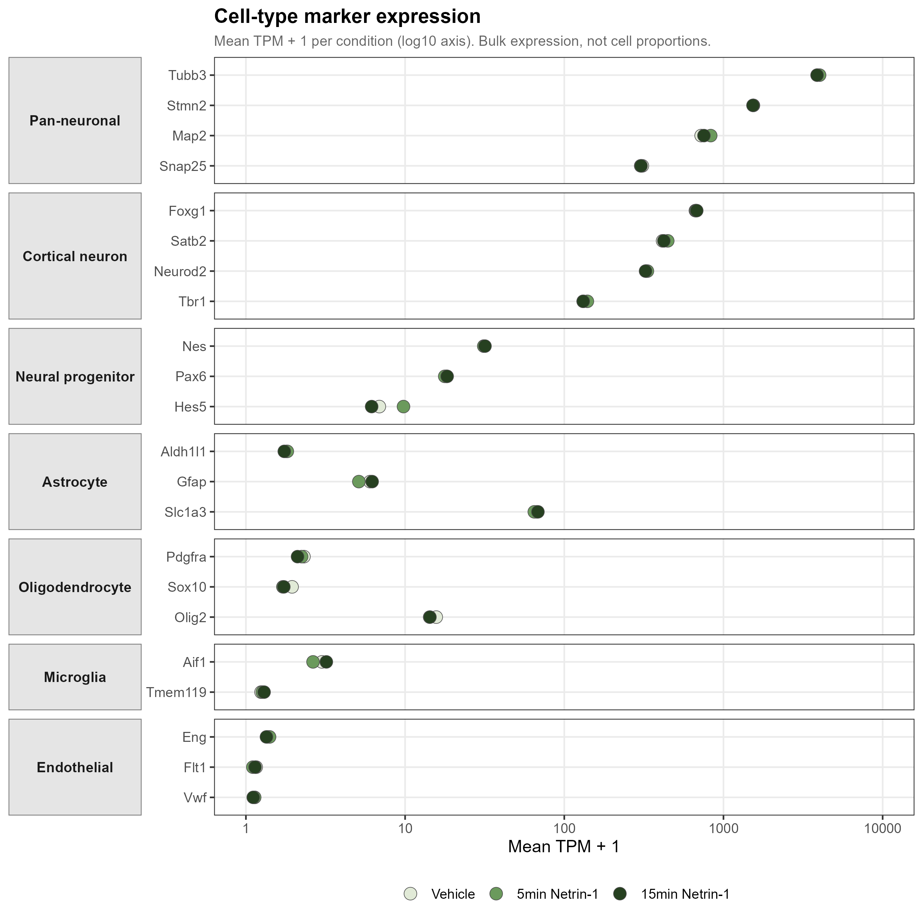
RESULTS · QC
QC I — neuron-dominated, composition-stable cultures
▸ Pan-neuronal markers dominate:
– Tubb3 ≈ 3900, Stmn2 ≈ 1540, Map2 ≈ 750 TPM.
– 2–4 orders above glial / endothelial markers (Vwf, Flt1 ≈ 0.1).
▸ Marker profile near-identical across all 3 conditions.
– → cell composition does NOT change.
▸ Downstream changes are a genuine transcriptional response — not a shift in cell-type proportions.
7
Notes:
~1.5 min. What are we sequencing, and is it stable? Pan-neuronal markers sit two to four orders of magnitude above glial and endothelial markers — neuron-dominated cultures. And the profile is essentially identical across all three conditions; five or fifteen minutes is far too short to change composition. So everything downstream is a real transcriptional response, not cells appearing or disappearing.

Slide 8
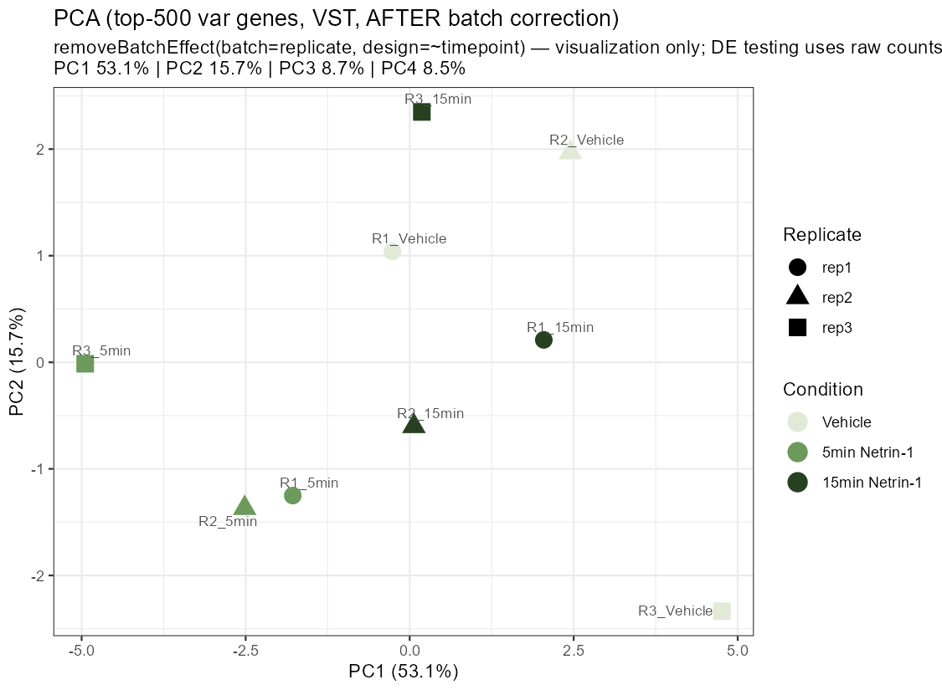
RESULTS · QC
QC II — replicate is the dominant variance source
▸ Top axis of variation = biological REPLICATE, not treatment.
– replicate ≈ 52% vs timepoint ≈ 34%.
▸ Handled correctly:
– replicate is a batch term in the DE model;
– limma removeBatchEffect for visualization only.
▸ After correction, PC1 reflects TIMEPOINT — samples separate by 0 / 5 / 15 min.
8
Notes:
~1.5 min. The largest source of variation is the biological replicate, not the treatment — 52 versus 34 percent. Ignore it and the signal drowns, so replicate is a batch term. This PCA is shown after correcting for replicate, for visualization, and now PC1 lines up with the timepoint axis. The statistics still run on raw counts.

Slide 9
RESULTS · DEGS
Differential expression by contrast
Contrast
Comparison
RELAXED
padj<0.05
STRICT
+FC>1.5
Direction (RELAXED)
5v0
5 min vs Vehicle
32
5
14 up / 18 down
15v5
15 min vs 5 min
6
2
6 up / 0 down
15v0
15 min vs Vehicle
1
1
0 up / 1 down
LRT
time-varying (any)
19
—
—
The acute response is real but small at the single-gene level — and it is the 5-minute contrast that carries it. This motivates the pathway-level GSEA.
9
Notes:
~1.5 min. Here is the DE landscape across contrasts. The 5-vs-0 contrast carries the response — 32 genes relaxed, 5 strict. By 15-vs-5 it's down to a handful, and 15-vs-0 is essentially nothing. The LRT flags 19 time-varying genes. The message: the signal is real but small per gene, and it lives at 5 minutes — which is exactly why I move to GSEA.

Slide 10
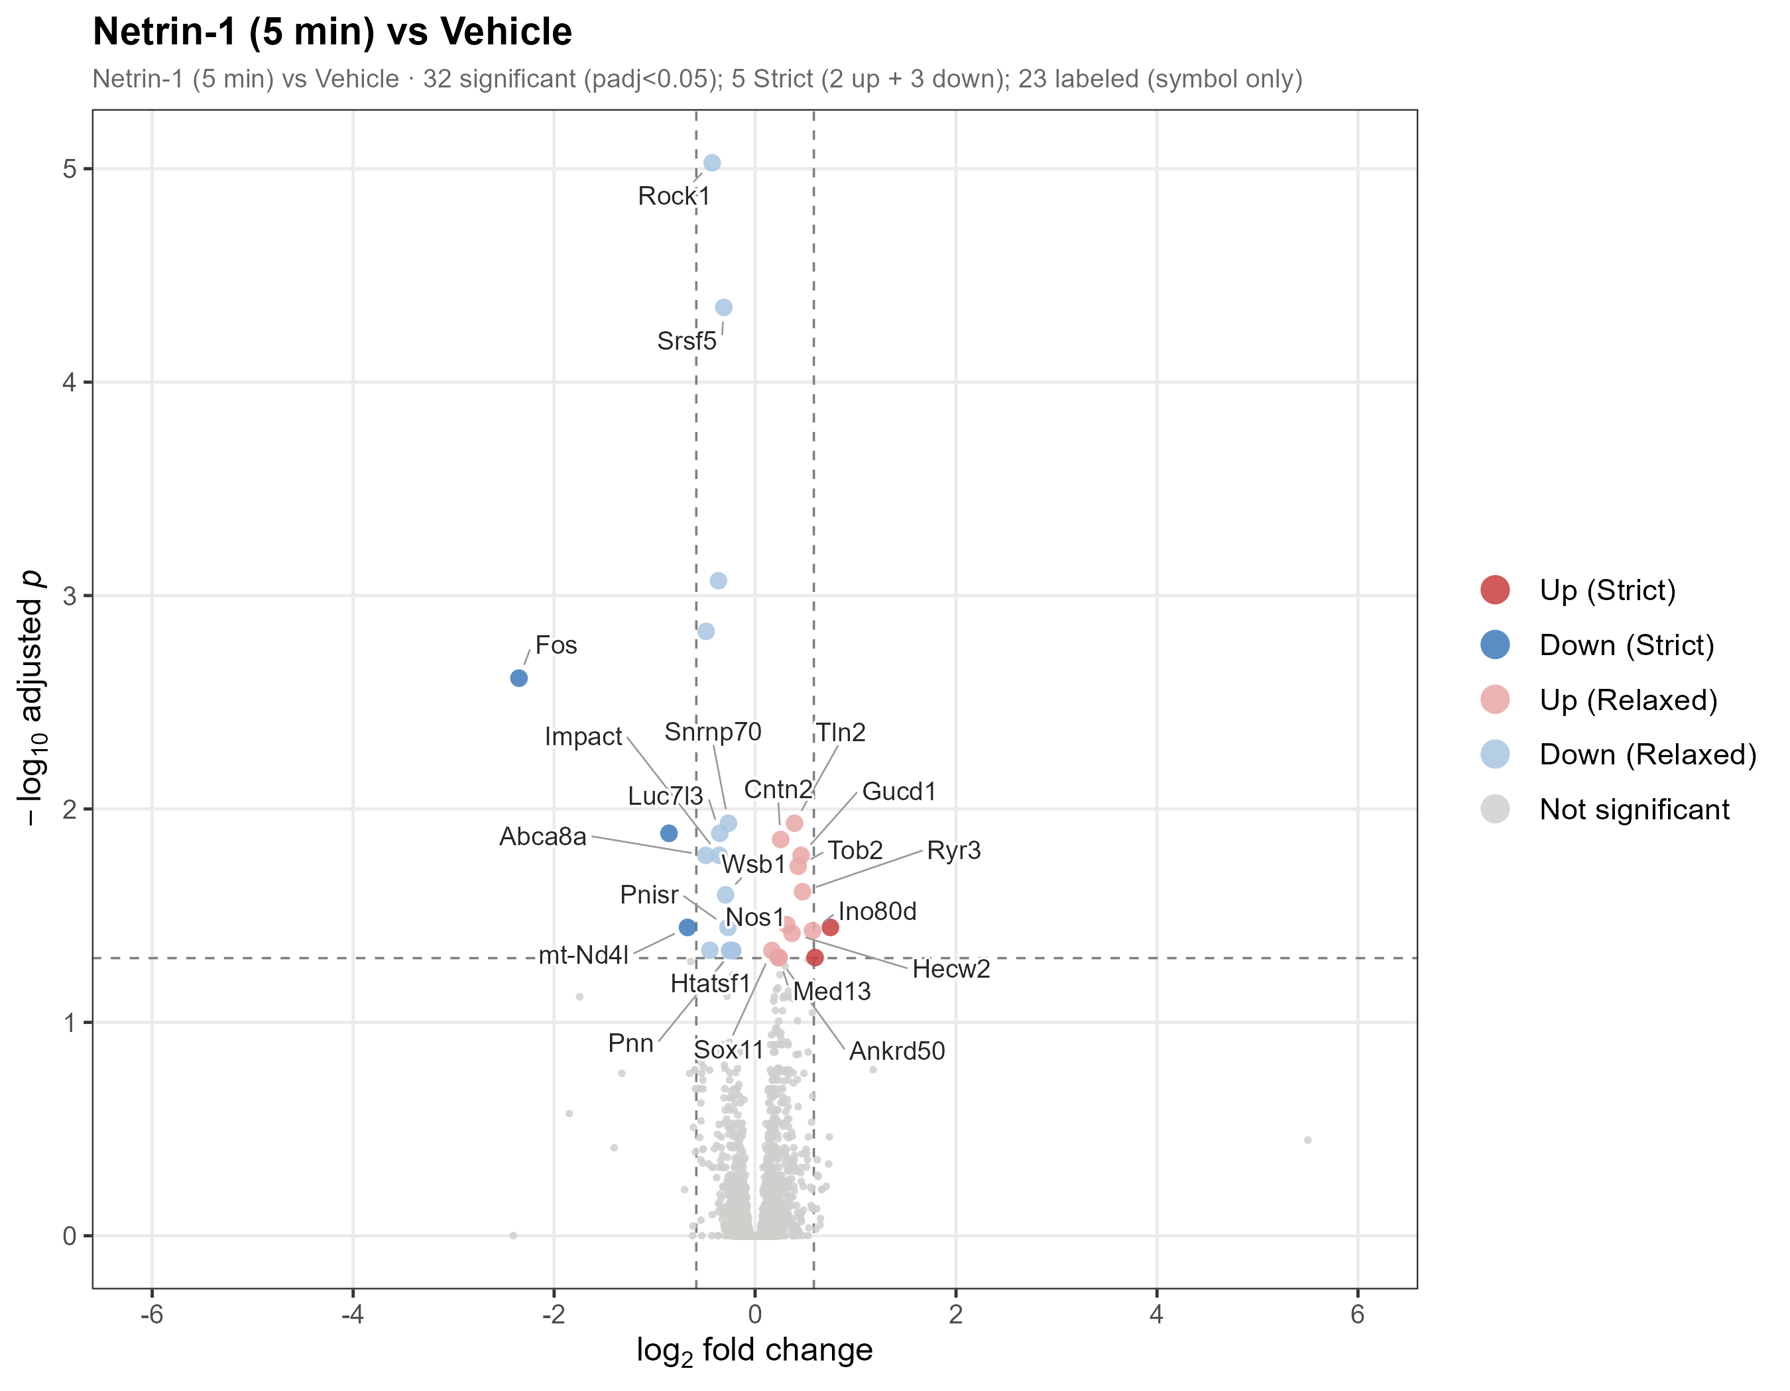
RESULTS · DEGS
The 5-minute response maps onto coherent modules
Gene
log2FC
padj
Module
Fos
−2.35
2.4e-3
IEG
Rock1
−0.43
9.4e-6
Cytoskeleton
Srsf5
−0.31
4.5e-5
Splicing
Snrnp70
−0.27
1.2e-2
Splicing
Cntn2
+0.25
1.4e-2
Axon guid.
Nos1
+0.32
3.5e-2
NO–calcium
Ryr3
+0.47
2.4e-2
NO–calcium
Tln2
+0.39
1.2e-2
Adhesion
Down: IEG, cytoskeleton, splicing. Up: guidance, NO–calcium, adhesion.
10
Notes:
~1.5 min. Zooming into the 5-minute contrast — volcano on the left, the significant genes on the right. The key point is the Module column: the down genes are Fos (an IEG), Rock1 (cytoskeleton), Srsf5 and Snrnp70 (splicing); the up genes are Cntn2 (guidance), Nos1 and Ryr3 (NO-calcium), Tln2 (adhesion). Small individually, but they sort into clean, interpretable modules — a preview of what GSEA confirms genome-wide.

Slide 11
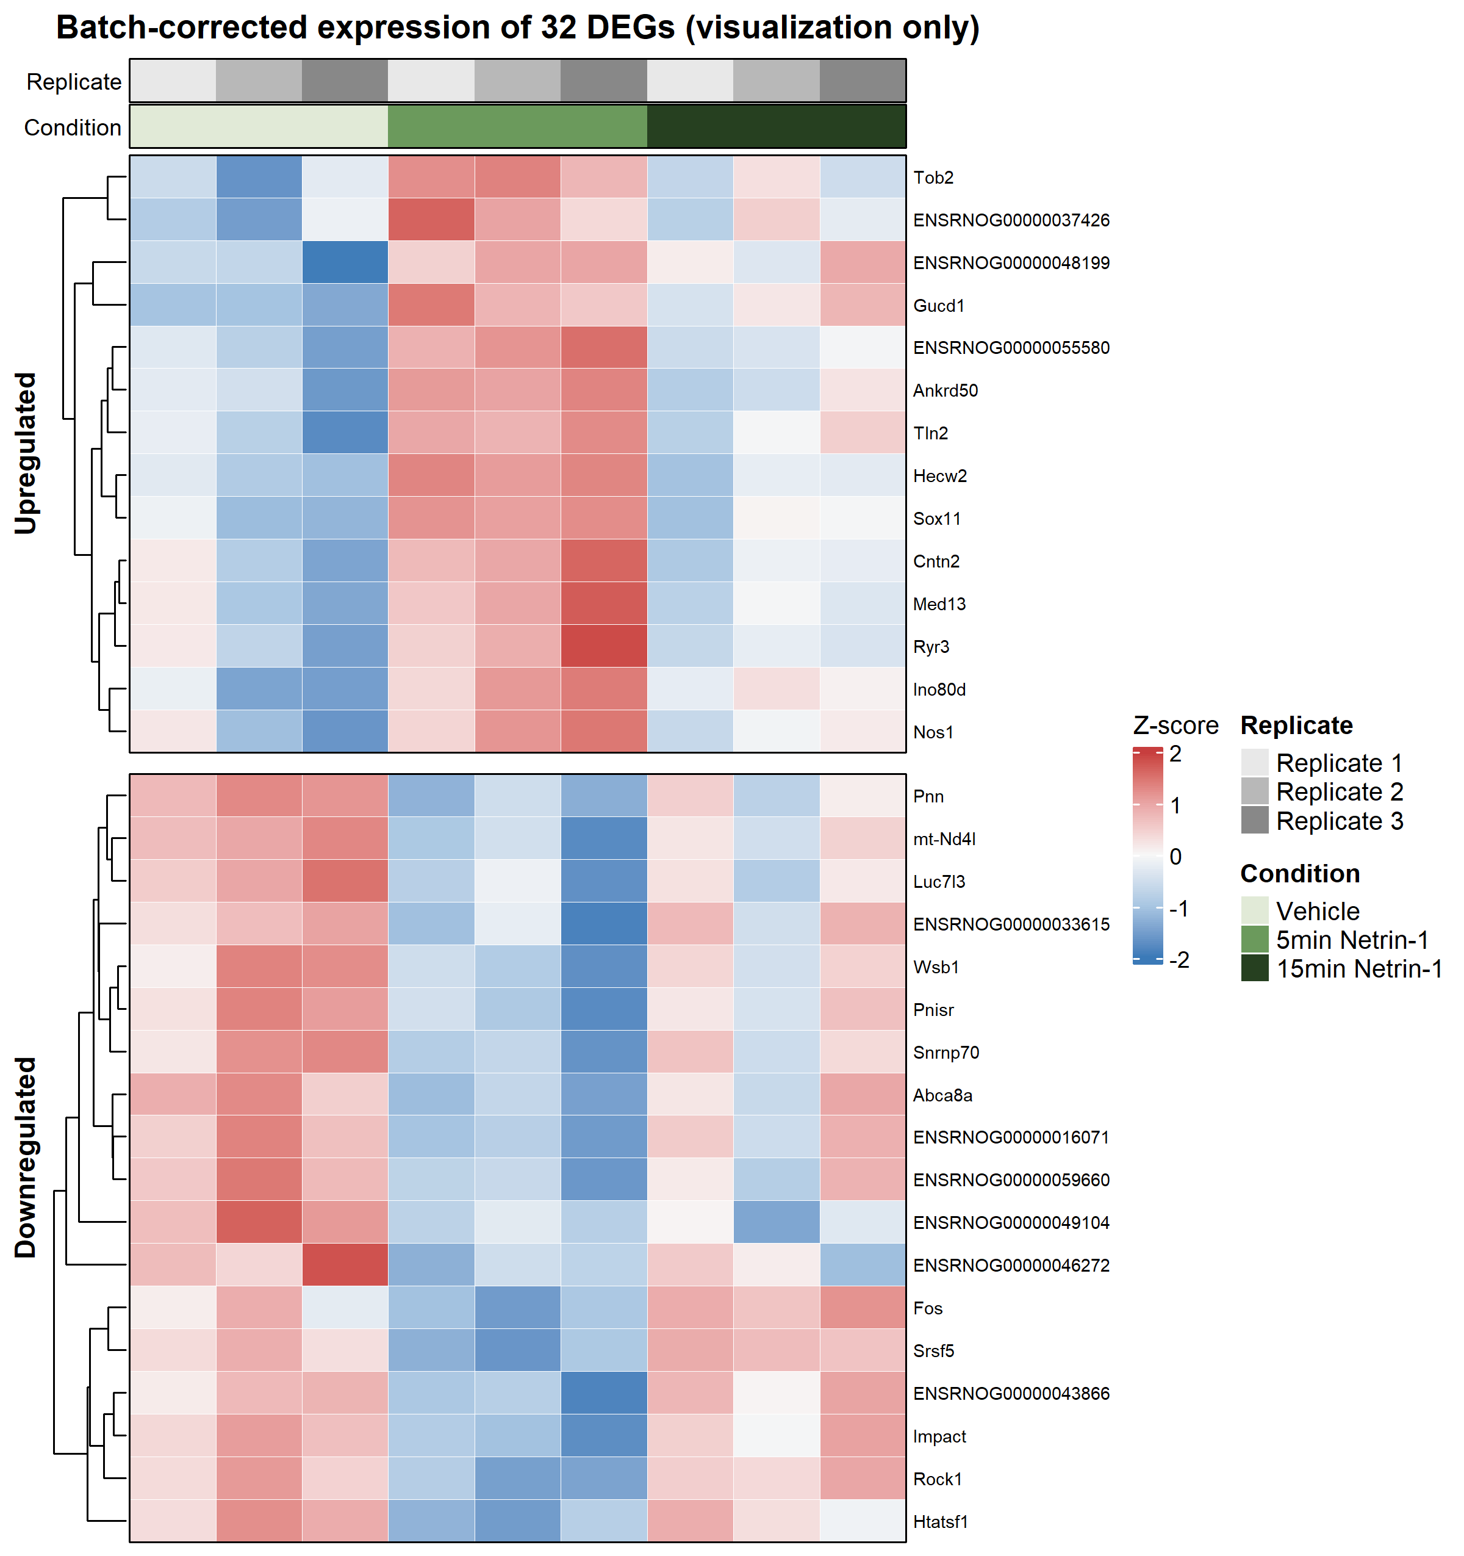
RESULTS · DEGS
DEGs form a coherent, condition-specific pattern
▸ Heatmap of 5v0 DEGs across all 9 samples.
▸ Coordinated up- and down-blocks distinguish the Netrin-5min condition.
▸ Patterns are consistent within replicates after batch handling.
▸ The 5-minute state is a distinct, structured program —
– not scattered noise across a few genes.
11
Notes:
~1 min. A consolidating view: the 5-vs-0 DEGs across all nine samples. You can see coherent up- and down-blocks that mark out the 5-minute Netrin state, consistent within replicates. The point is that the response holds together as a structured pattern across the matrix.

Slide 12
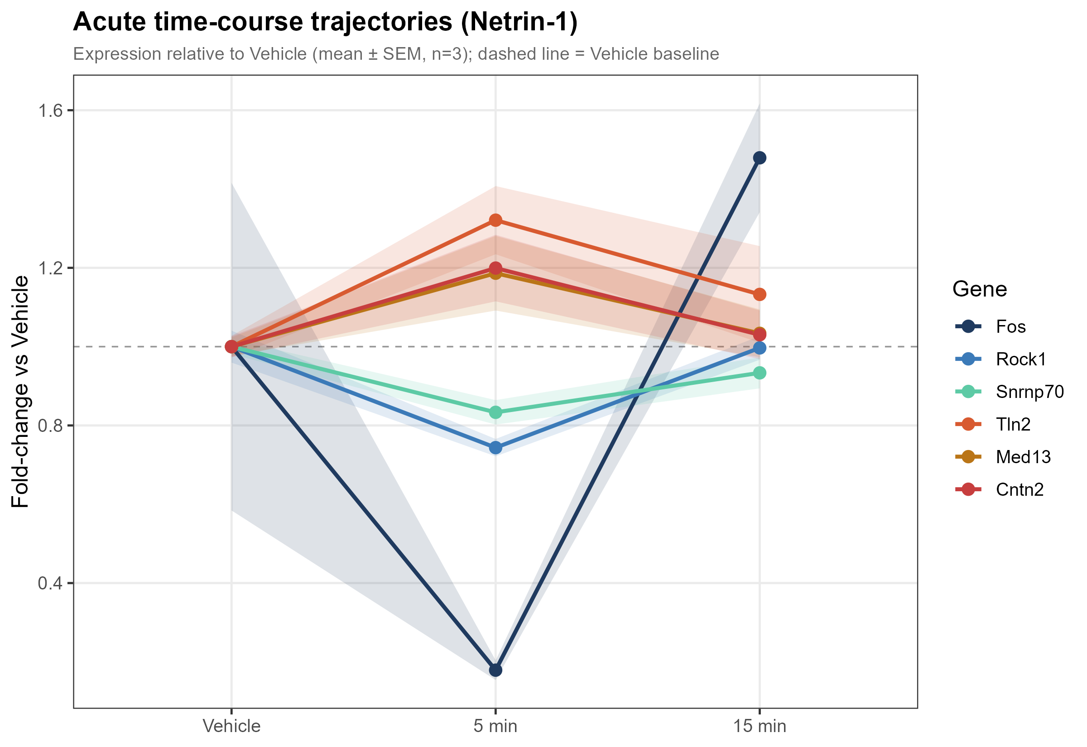
RESULTS · DYNAMICS
The response is a transient 5-minute pulse
▸ LRT: 19 genes change significantly over time.
▸ Dominant shape = a 5-minute PULSE:
– depart from baseline at 5 min…
– …return toward baseline by 15 min.
▸ First direct evidence the program is transient, not sustained.
▸ Caveat (shown honestly):
– Fos overshoots baseline at 15 min; variable Vehicle replicates → wide error band.
12
Notes:
~1.5 min. This answers the transient-versus-sustained question. The LRT flags 19 time-varying genes, and the dominant trajectory is a pulse: away from baseline at 5 minutes, back by 15. First direct evidence of transience. One honest caveat: Fos overshoots baseline at 15 minutes and its vehicle replicates are noisy, so its band is wide.

Slide 13
RESULTS · DYNAMICS
A surprise: two immediate-early genes are suppressed
Immediate-early genes are normally ACTIVATED by neuronal activity — here, acute Netrin-1 acutely DOWN-regulates them.
Fos
log2FC −2.35 · padj 2.4e-3
The strongest DEG of the study.
A strong, significant acute IEG repression.
Npas4
log2FC −1.75 · padj 0.076 (n.s.)
Significant by the time-course LRT.
A second acute IEG repression.
13
Notes:
~1.5 min. One of the most striking findings. IEGs like Fos and Npas4 are textbook markers of neuronal ACTIVATION — they go up within minutes. Here acute Netrin does the opposite. Fos is down more than fourfold, the strongest DEG in the study. Npas4 is down about 3.4-fold; it misses the per-contrast cut but is significant by the time-course LRT. Two independent IEGs acutely repressed — novel and counterintuitive.

Slide 14
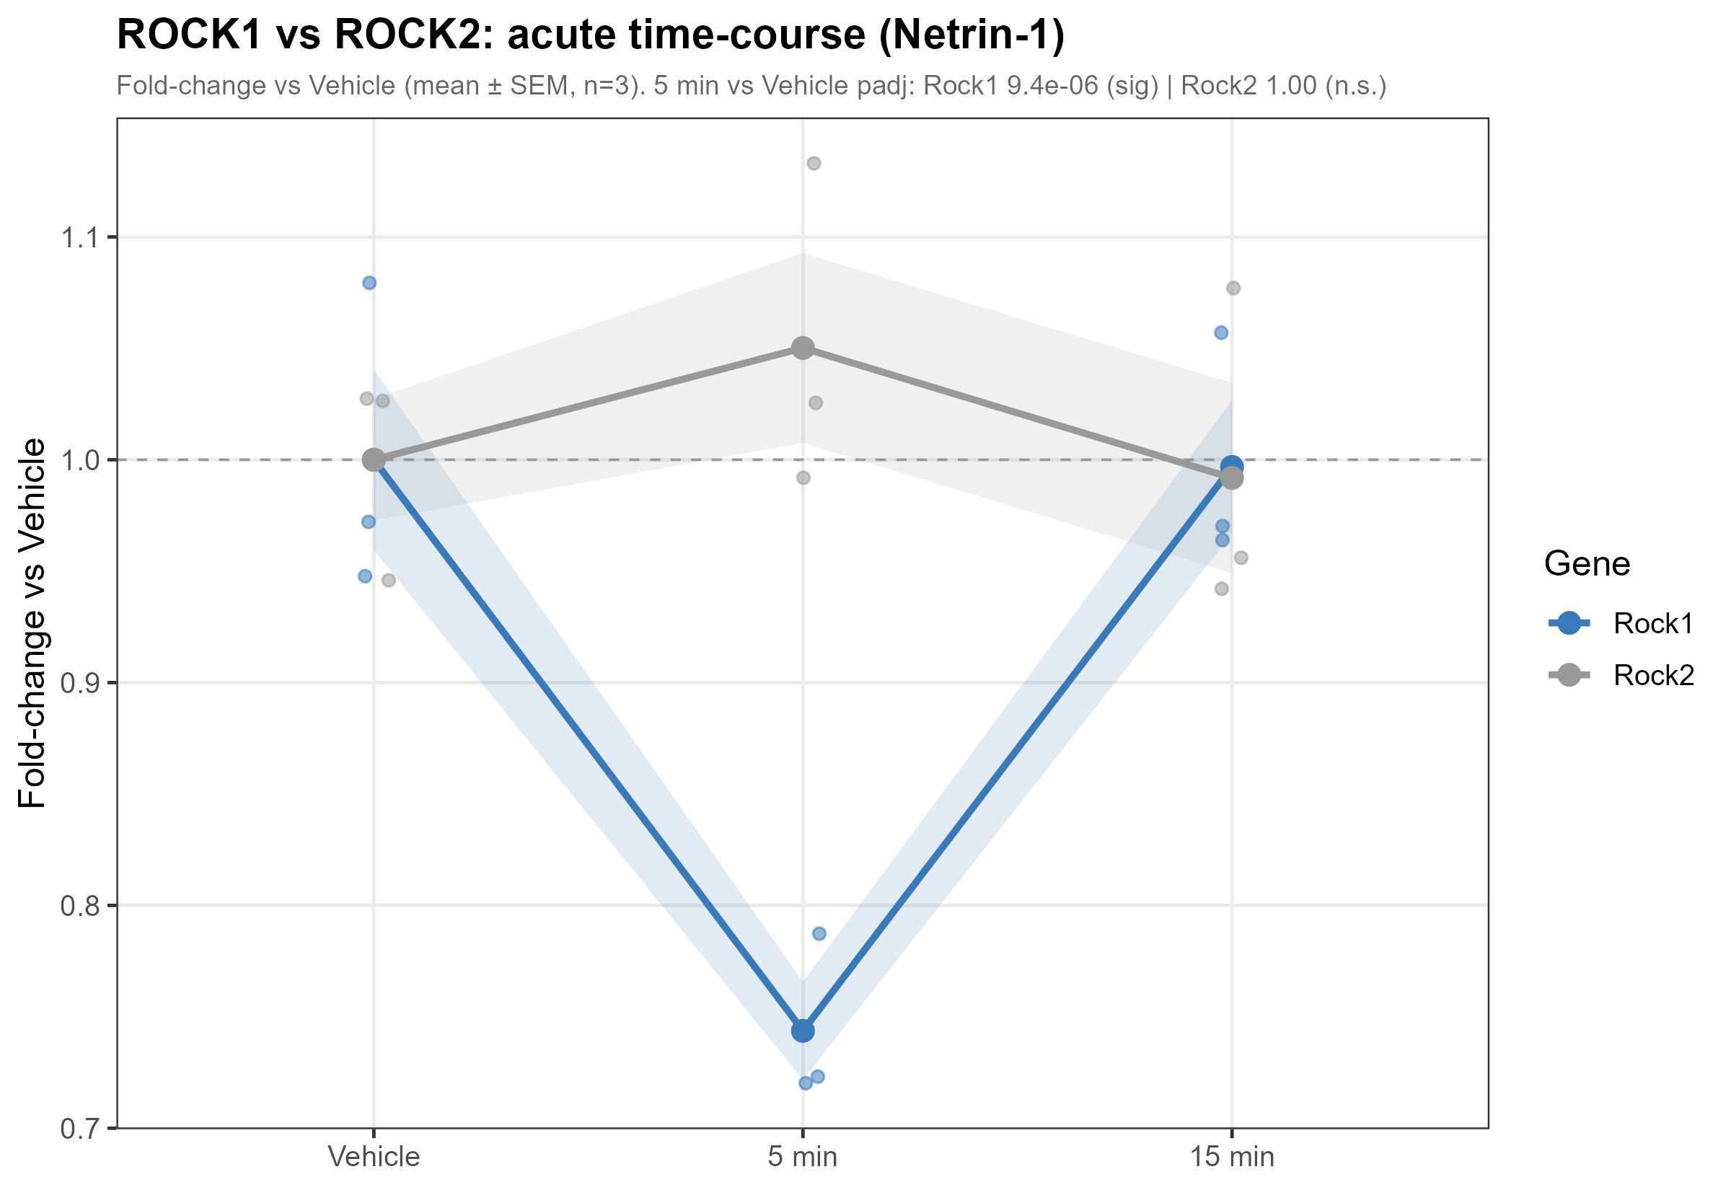
RESULTS · DYNAMICS
Isoform-selective control: Rock1 down, Rock2 untouched
▸ Rock1: log2FC −0.43, padj 9.4e-6 — clearly DOWN.
▸ Rock2: log2FC +0.07, padj ≈ 1.0 — unchanged.
▸ Two paralogues, opposite fates in one cell.
▸ ROCK1 is a classic Netrin–DCC downstream effector.
▸ → Netrin exerts precise, isoform-selective transcriptional control — not a blunt instrument.
14
Notes:
~1.5 min. A nice illustration of precision. ROCK kinases come in two paralogues. Netrin selectively knocks down Rock1 — highly significant — while Rock2 doesn't move at all. Same cell, same family, opposite outcomes. And ROCK1 is a canonical Netrin-DCC effector, so this dovetails with the known protein-level biology. The response is selective.

Slide 15
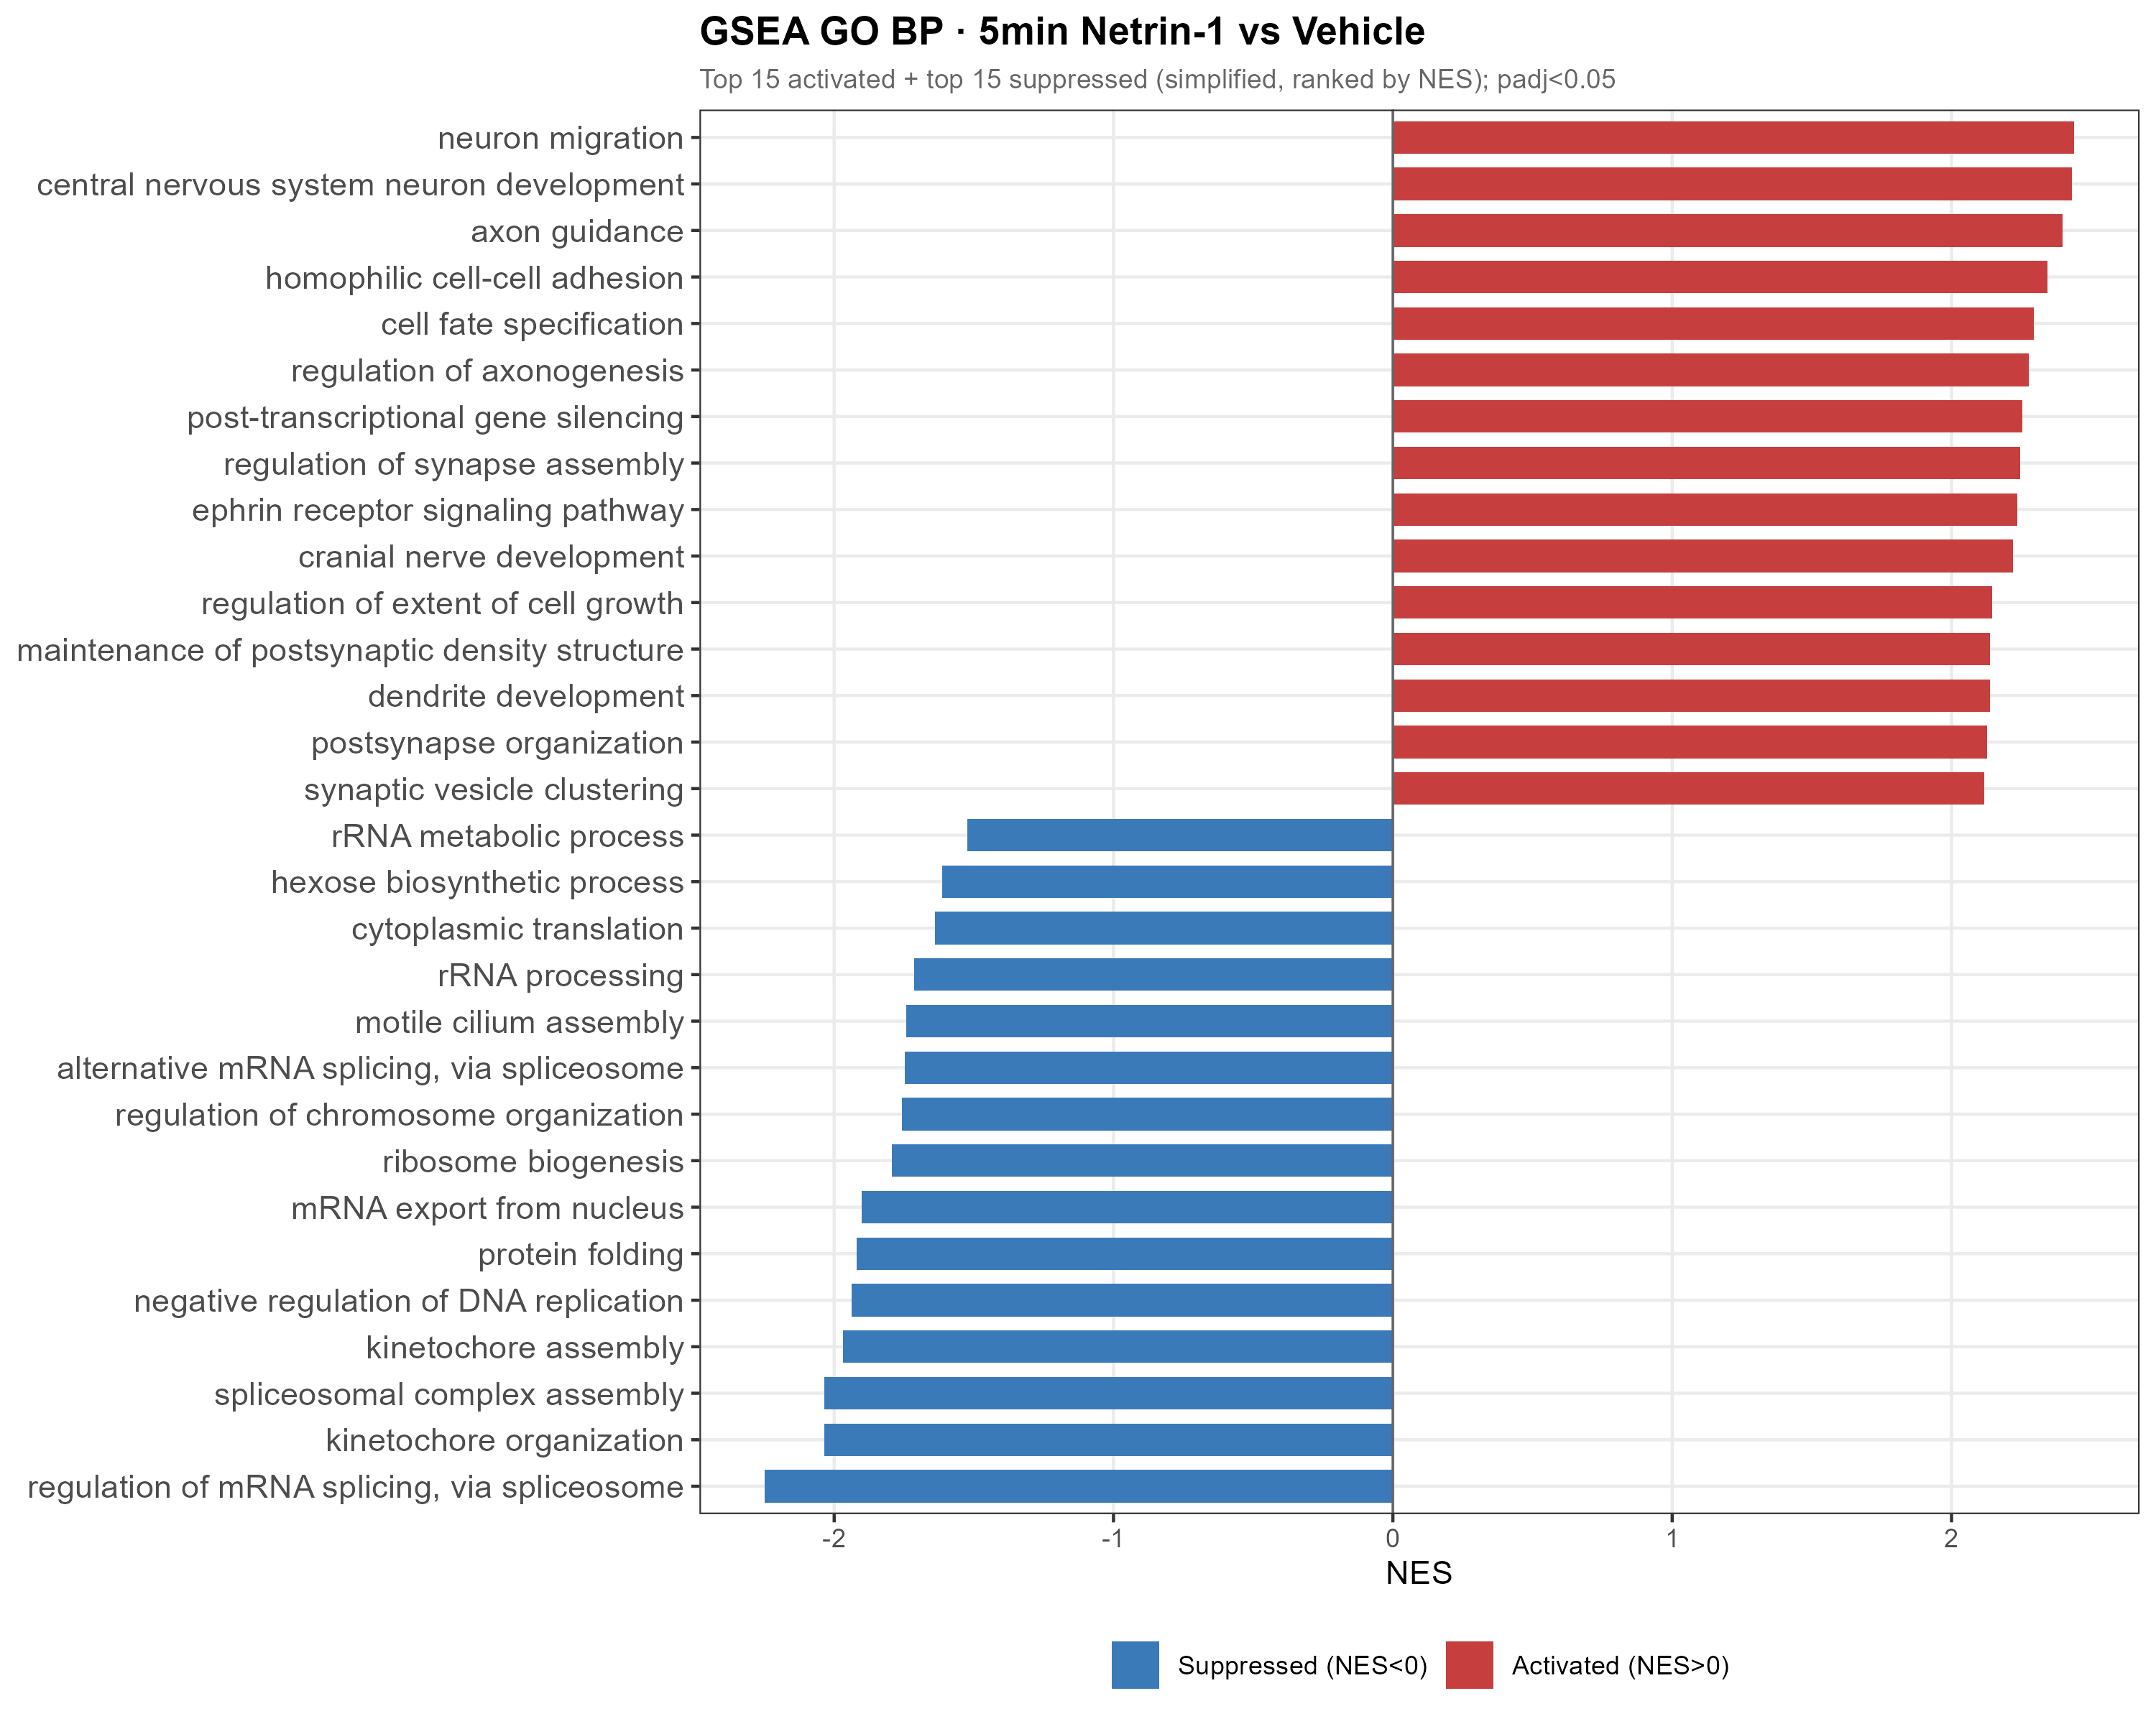
RESULTS · PATHWAYS
GSEA: a coordinated program at 5 minutes
▸ 5v0 GO-BP: 313 significant (285 ↑ / 28 ↓).
▸ ACTIVATED at 5 min:
– axon guidance, neuron projection, synapse assembly.
▸ SUPPRESSED at 5 min:
– mRNA splicing / processing,
– ribosome biogenesis & translation.
▸ GSEA lifts the single-gene modules into a genome-wide coordinated signal.
15
Notes:
~1.5 min. This is where it comes together. At the pathway level the 5-minute response is unmistakable — 313 GO terms. Activated: axon guidance, neuron projection, synapse assembly — Netrin's own territory, at the transcriptional level in minutes. Suppressed: RNA processing and ribosome biogenesis — the general biosynthetic machinery. The same modules, now genome-wide. This is the core result.

Slide 16
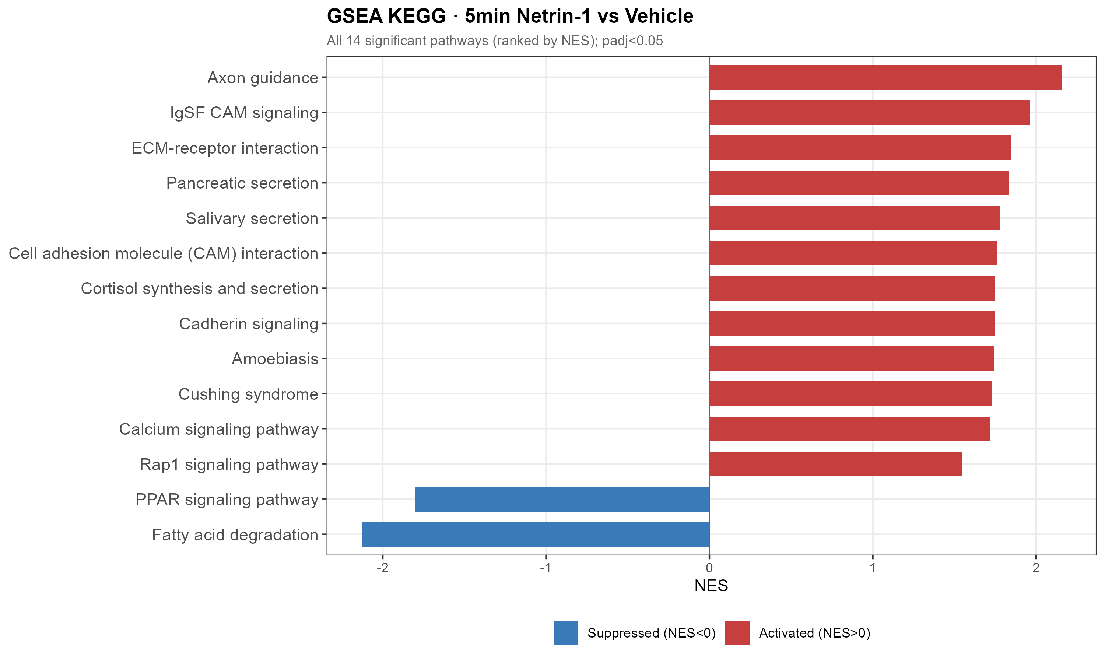
RESULTS · PATHWAYS
KEGG: axon guidance tops the activated pathways
▸ 5v0 KEGG: 14 significant pathways.
▸ Top pathway: Axon guidance.
– NES 2.16 · BH p = 4.1e-7.
– includes the parallel ephrin system.
▸ Netrin's canonical protein-level function, mirrored transcriptionally within 5 minutes.
– transcription runs in PARALLEL with the classic mechanism.
16
Notes:
~1.5 min. KEGG sharpens it. Of 14 pathways, axon guidance ranks first — NES 2.16, p around 4e-7 — and brings the ephrin system with it. Netrin's classic job is steering growth cones through fast protein signaling; here the same guidance program is switched on transcriptionally in five minutes. So transcription runs in parallel with the canonical mechanism, not hours later.

Slide 17
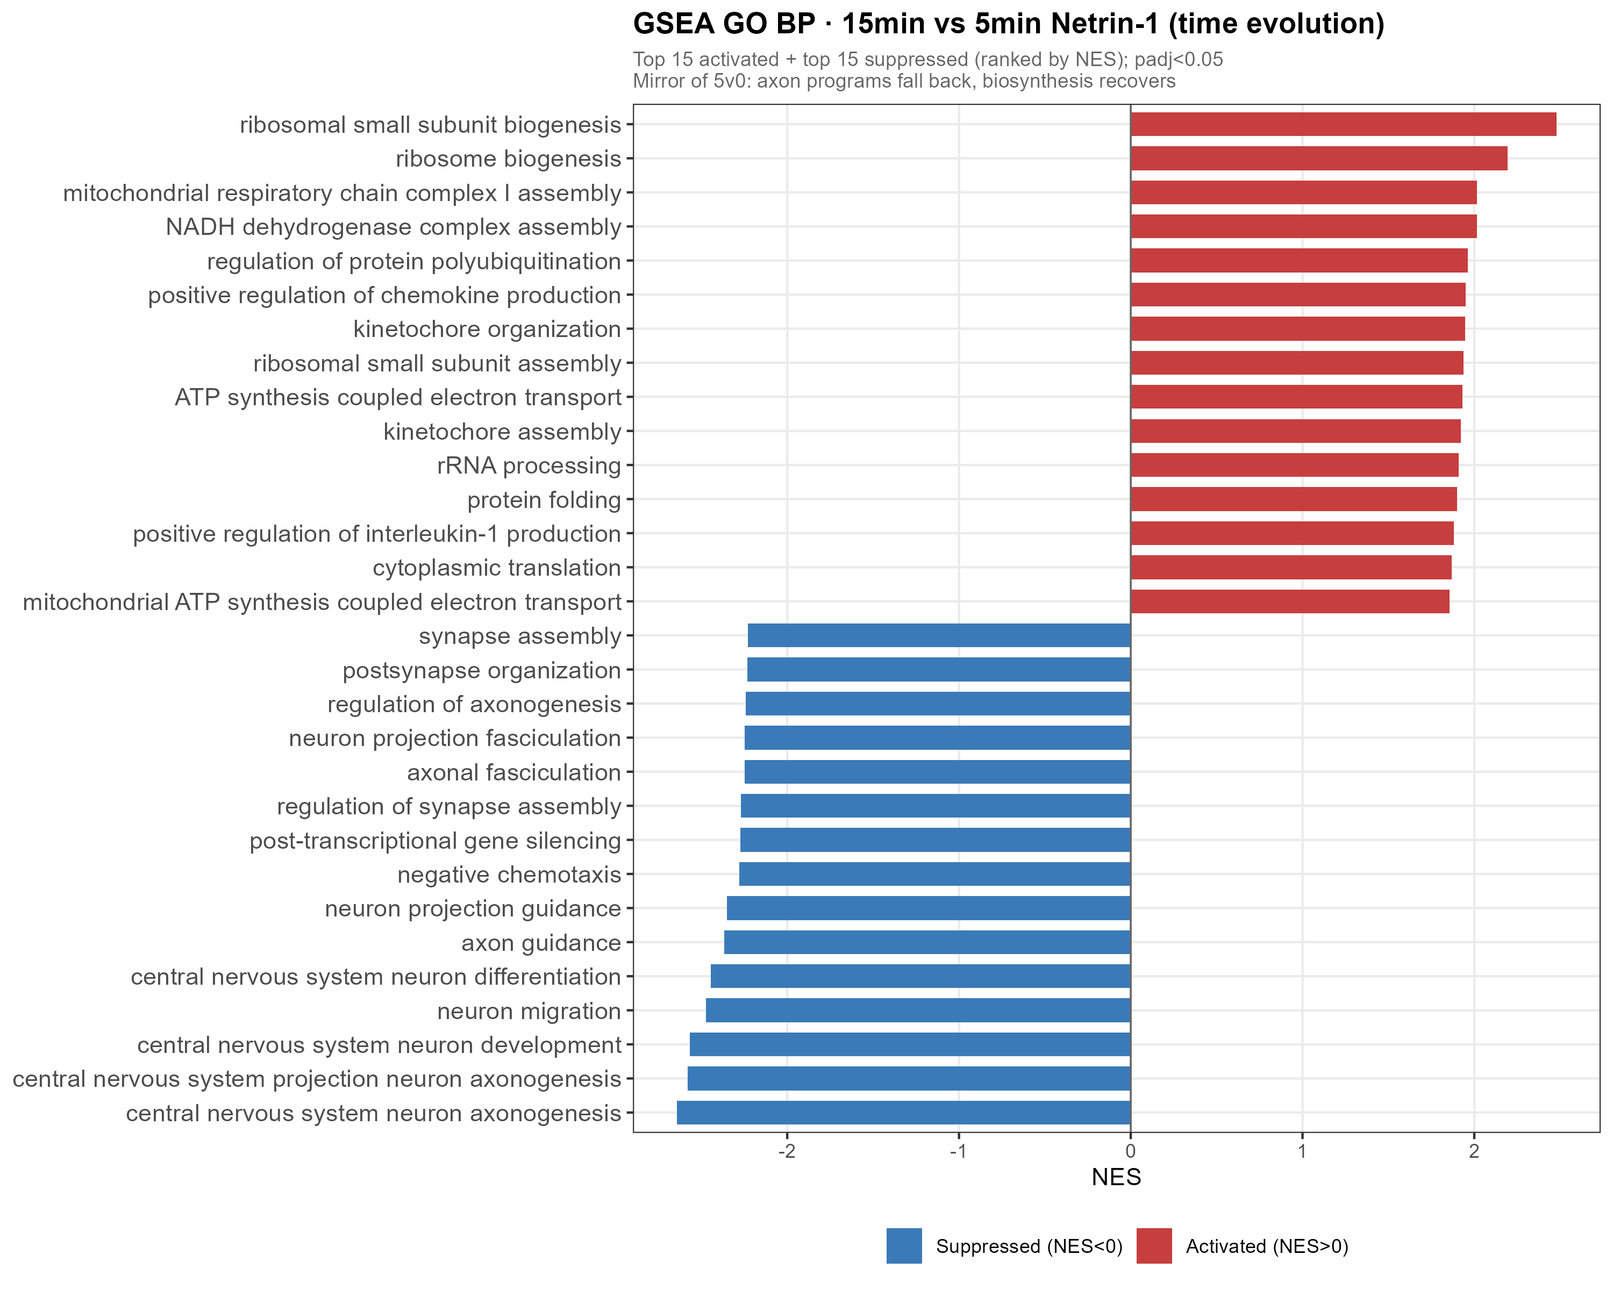
RESULTS · RETURN
By 15 minutes the program fully reverses
▸ 15v5 GO-BP: 295 significant (31 ↑ / 264 ↓).
▸ Direction FLIPPED versus 5v0:
– axon-guidance terms now go DOWN,
– biosynthesis terms now go UP (recover).
▸ 15v0 GO-BP: 0 significant terms.
– → at 15 min the transcriptome is back at baseline.
▸ Switched on at 5 min, off by 15.
17
Notes:
~1.5 min. The loop closes. In 15-vs-5, 295 terms — but the sign is reversed: guidance going down, biosynthesis recovering. And the clincher: 15-vs-0 has ZERO significant GO terms. By 15 minutes the transcriptome is statistically indistinguishable from baseline. On at 5, off by 15. Now let me quantify how precise that reversal is.

Slide 18
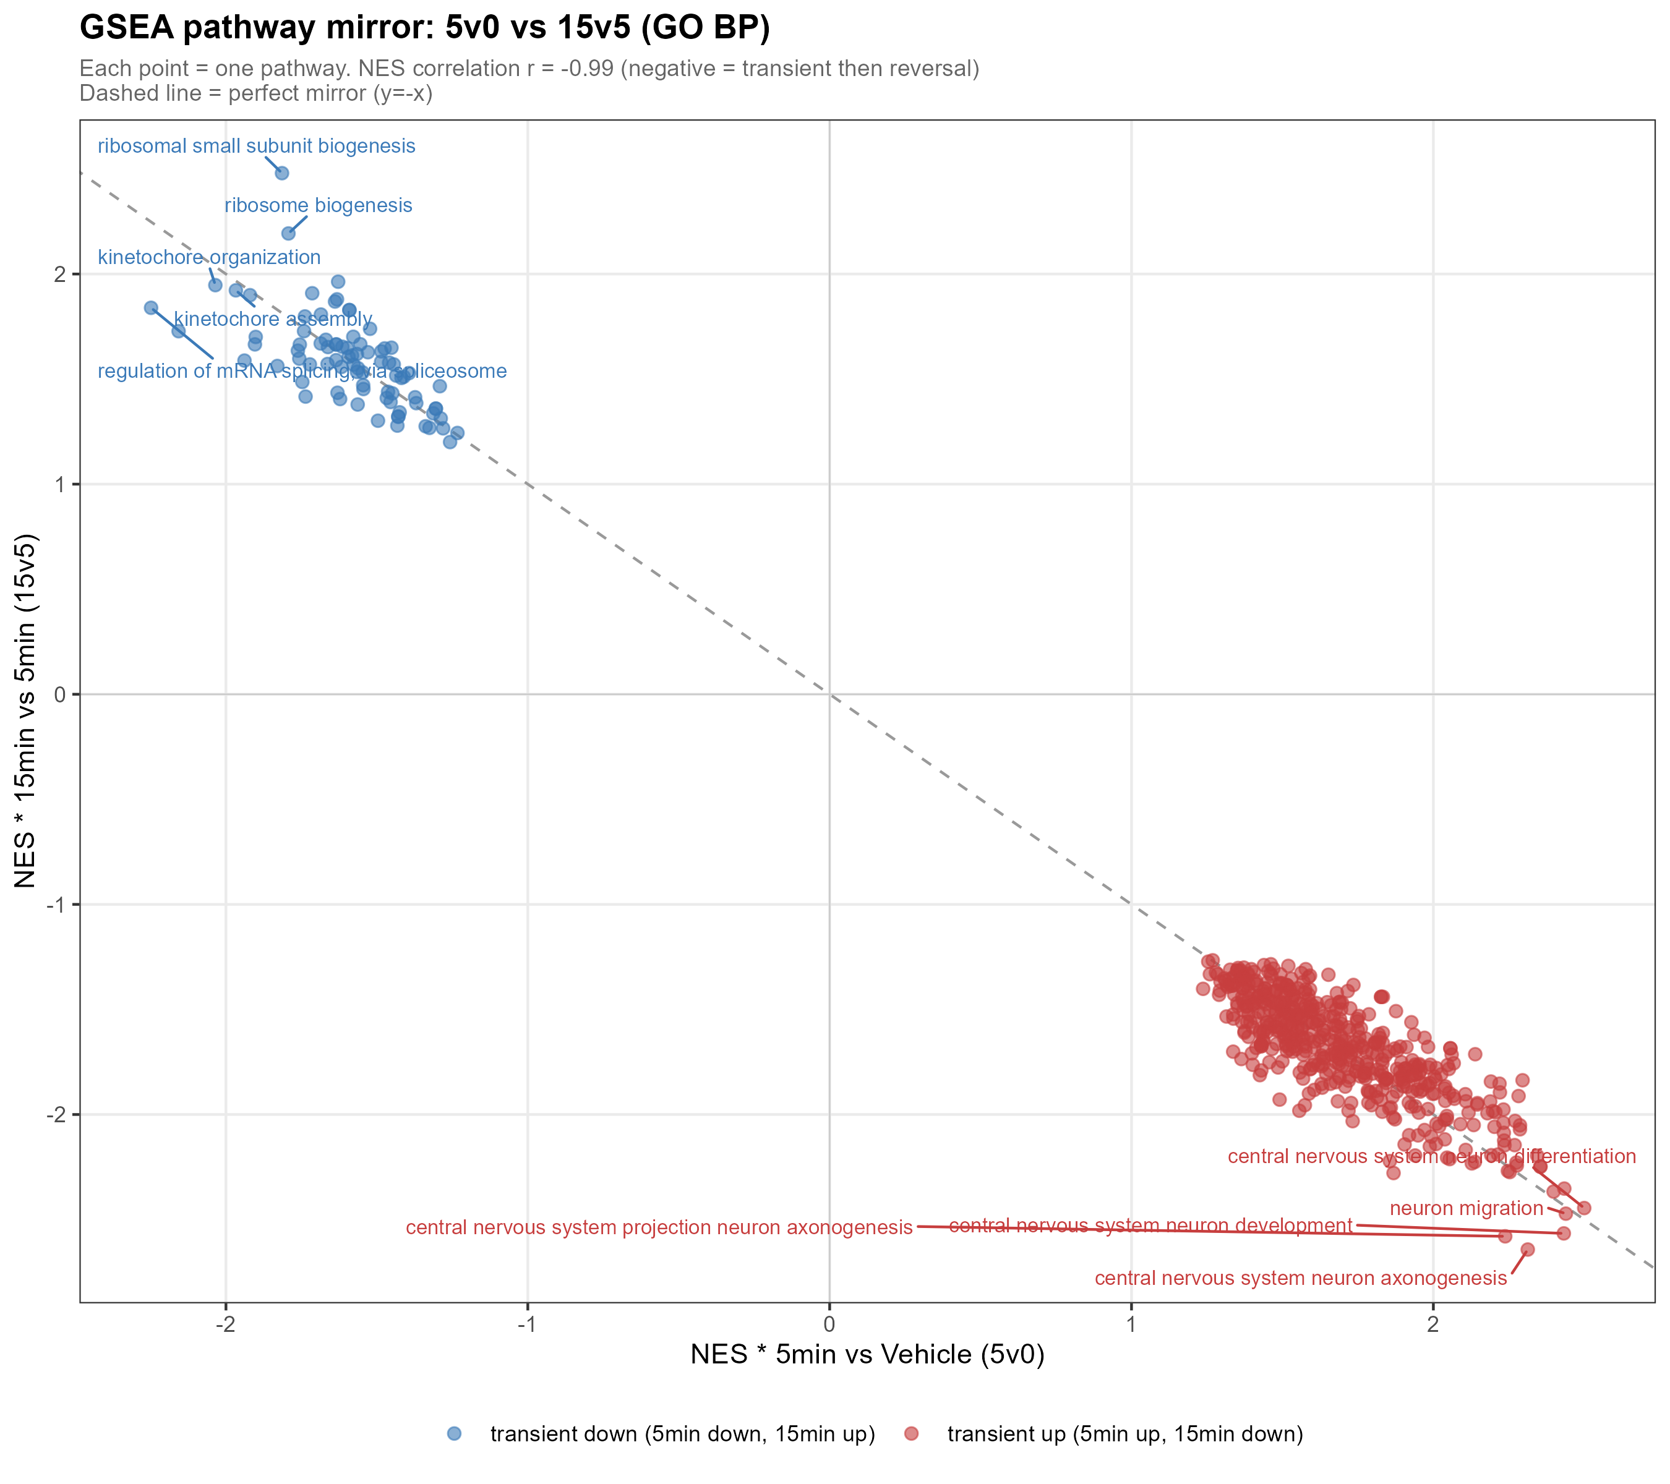
RESULTS · RETURN
The signature result: an r = −0.99 mirror
r = −0.99
5v0 vs 15v5 pathway NES correlation
▸ 603 pathways shared between 5v0 and 15v5.
▸ Their enrichment scores are near-perfect opposites.
▸ Every pathway up at 5 min is suppressed 5→15 min by almost exactly the same amount.
▸ Quantitative proof of a precisely-undone transient.
18
Notes:
~2 min. The slide to remember. Taking the 603 pathways shared between 5v0 and 15v5 and plotting their enrichment scores against each other gives a correlation of minus 0.99 — a near-perfect anti-correlation. Every pathway up in the first five minutes comes back down over the next ten by almost exactly the same magnitude. This is the quantitative backbone: the 5-minute program is not fading randomly, it is being precisely reversed. That is the definition of a tightly-controlled transient, and the study's strongest single result.

Slide 19
SYNTHESIS
Integrated summary: DESeq2 + GSEA
DESeq2
GSEA (GO-BP)
Comparison
RELAXED
STRICT
Direction
Terms
Direction
5 min vs Vehicle
32
5
14 ↑ / 18 ↓
313
285 ↑ / 28 ↓
15 min vs 5 min
6
2
6 ↑ / 0 ↓
295
31 ↑ / 264 ↓
15 min vs Vehicle
1
1
0 ↑ / 1 ↓
0
0
One coherent program: a 5-minute swing (guidance up, biosynthesis & IEGs down) that reverses by 15 minutes — at both the gene and pathway level.
19
Notes:
~1.5 min. The whole study on one table, DESeq2 next to GSEA. Read down the rows: the 5-minute contrast carries everything — 32 genes, 313 pathways. By 15-vs-5 the pathway direction has flipped — 264 of 295 now going down. And 15-vs-0 is zero on both sides: back to baseline. Gene level and pathway level tell the identical transient story.

Slide 20
DISCUSSION
Discussion & limitations
TAKE-HOME MESSAGES
LIMITATIONS
▸ Dual-IEG suppression (Fos + Npas4) — opposite to canonical IEG behavior. Novel.
▸ Coordinated transient shutdown of biosynthesis (splicing + ribosome + translation).
▸ Guidance program has a fast transcriptional arm, parallel to the classic mechanism.
▸ r = −0.99 mirror — a precisely-controlled transient, not reprogramming.
▸ ROCK1-selective control of a canonical Netrin–DCC effector.
▸ n = 3, acute signal weak → GSEA is the primary analysis.
▸ No independent PBS-15min control → rely on 5v0 and 15v5.
▸ Only 3 timepoints → LRT + trend, not dense time-series modeling.
▸ Fos shows high Vehicle-replicate variability → read cautiously.
▸ Bulk RNA-seq → markers reflect expression, not cell proportions.
20
Notes:
~2 min. Five take-homes, left: dual-IEG suppression, novel; a coordinated transient biosynthesis shutdown, perhaps resource reallocation to local translation; a fast transcriptional arm of the guidance program; the minus-0.99 mirror; and ROCK1-selective control. Right, the limitations that shaped my choices: n=3 and a weak signal, hence GSEA primary; no 15-minute vehicle, hence the clean contrasts; only three timepoints; Fos's variability; and bulk, not single-cell. None undercut the central transient result, but they bound its interpretation.

Slide 21
WRAP-UP
Conclusions
Acute Netrin-1 triggers a rapid, coordinated and TRANSIENT transcriptional program — activating axon-guidance / projection while suppressing RNA processing and ribosome biogenesis — reversed to baseline with r = −0.99 precision within 15 minutes.
▸ First characterization of Netrin-1's minute-scale transcriptional response.
▸ Transcription runs in PARALLEL with the classic post-translational mechanism.
▸ Novel: dual-IEG suppression and ROCK1-selective regulation.
▸ The r = −0.99 mirror defines a precisely-controlled transient.
21
Notes:
~1.5 min. To conclude: the first characterization of Netrin's minute-scale transcriptional response. The headline — rapid, coordinated, transient; guidance up, biosynthesis down; reversed with r = minus 0.99 within 15 minutes. Transcription parallels the protein mechanism; two novel findings in dual-IEG suppression and ROCK1 selectivity; and the mirror reframes the response as a precisely-controlled transient.

Slide 22
Thank you
Questions & discussion welcome
One sentence to remember:
A 5-minute Netrin-1 pulse switches a coordinated transcriptional program ON — then OFF again by 15 minutes, with r = −0.99 precision.
Notes:
~0.5 min + Q&A. Thank you. One sentence: a five-minute Netrin pulse switches a coordinated program on, then off by fifteen minutes, with r = minus 0.99 precision. Likely questions: why IEGs go down; mirror robustness at n=3; the shared-control limitation; bulk vs subtype effects.

